Slide 1



Module 4
Programming with Copilot – Intermediate

Slide 2

Disclaimer
The content is curated from online/offline resources and used for educational purpose only

Slide 3

Learning Objective
You will learn in this Chapter:
Implement decision-making (if-else) and repetition (for/while loops) using effective Copilot prompts
Define and use functions to promote code reuse and readability (DRY principle)
Work with basic data structures: lists and dictionaries, including iteration and manipulation
Apply Copilot-assisted debugging techniques to identify and resolve common errors
Write precise, intermediate-level prompts to generate reliable, efficient code
Notes:
These are our clear, measurable objectives for today. We will cover each systematically, with live demonstrations of Copilot in action. Notice the emphasis on effective prompting – this is the key skill that turns Copilot from a suggestion tool into a reliable programming partner. By mastering these, you will write more structured, maintainable, and professional Python code faster than manual typing alone. We start with a brief justification for moving to intermediate concepts.

Slide 4
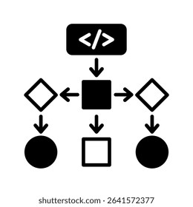
Why Logical Flow in Programming
Real-world programs require:
Repetition (processing multiple items)
Reuse (avoid duplicating logic)
Organization (structured data handling)
Copilot accelerates these by suggesting patterns, reducing errors, and refactoring code
Code execution follows logical flow: Sequence → Decisions (if/else) → Repetition (loops)
Analogy: Structured daily routine (sequence of tasks, decisions based on conditions, repeated actions)
Source: https://www.shutterstock.com/search/logic-flow
Notes:
Simple scripts from Module 3 handle one-time or linear tasks. However, most practical applications – grading systems, inventory trackers, data processors – demand repetition over collections, conditional logic, and modular design.
Copilot excels here: it recognizes intent from clear comments and suggests optimized structures (loops instead of repeated print statements, functions instead of copied blocks).
Think of code as telling a logical story: first do this (sequence), then decide based on conditions, and repeat actions as needed.
This mirrors how we structure everyday routines with decisions and repetition.
Next, we review flowchart notation – a visual tool to plan this logic before coding.

Slide 5
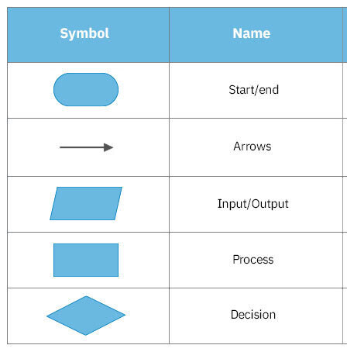
Flowchart Basics + Decisions with Copilot
Standard flowchart symbols:
Oval: Start/End
Rectangle: Process/Action
Diamond: Decision (Yes/No)
Parallelogram: Input/Output
Arrow: Flow direction
Loop representation: Arrow returning to previous decision/process
Copilot for decisions: Write descriptive comment → accept suggestion Example prompt in code:
Python (Write comment to get copilot suggestion)
# Check if a student's score is greater than or equal to 60 and print "Pass" or "Fail"
Accept Copilot suggests: if score >= 60:
print("Pass")
else: print("Fail")
Source: https://www.smartdraw.com/flowchart/flowchart-symbols.htm
Notes:
Flowcharts help plan program logic visually before writing code – especially useful for decisions and loops.
Key symbols: start/end (oval), process (rectangle), decision (diamond with Yes/No branches), input/output (parallelogram), and arrows.
For loops, we see a returning arrow after checking the condition (repetition until false).
Now, live demo in VS Code: [Open VS Code, new file, type the comment exactly as shown]
Watch Copilot suggest the if-else structure almost instantly.
Accept with Tab, run with sample score = 75 → see "Pass". Change to 55 → "Fail".
This is faster and less error-prone than typing manually. Next slide shows how to make prompts even more effective.

Slide 6
Good vs Bad Prompts for Decisions
Bad (vague) prompt → unreliable or incomplete suggestion:
Prompt:
# if
Copilot may suggest nothing useful or generic code
Good (specific, descriptive) prompt → accurate, complete suggestion:
Prompt
# If temperature is above 30 degrees, print "Hot day - stay hydrated", else print "Normal day"
# Include variable temperature as input from user
Copilot generates:
temperature = float(input("Enter temperature: "))
if temperature > 30:
print("Hot day - stay hydrated")
else:
print("Normal day")
Principle: The clearer and more detailed the comment, the better Copilot understands your intent
Notes:
Prompt quality directly affects output quality – this is a core intermediate skill. Vague prompts like "# if" give poor or no results. Specific, natural-language comments describing variables, conditions, and actions yield precise, ready-to-use code.
VS Code with comment → suggestion highlighted in gray/green]
Here is a real VS Code capture: detailed comment on left, Copilot inline suggestion appears.
Always review accepted code: run it, test edge cases (e.g., temperature = 30), understand every line.
This practice builds both efficiency and deep comprehension.
With decisions covered, we now move to repetition – loops – which are essential for handling collections of data.

Slide 7
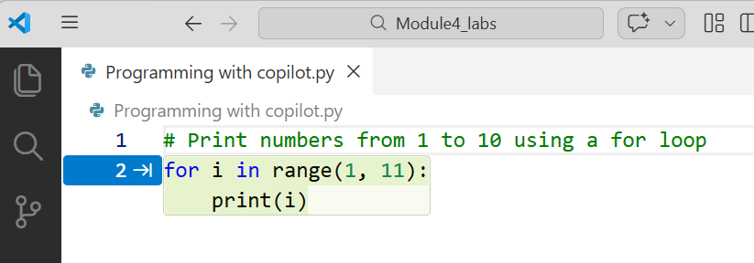
What are Loops?
Copilot example prompt:
# Print numbers from 1 to 10 using a for loop
Copilot suggests:
for i in range(1, 11):
print(i)
Loops enable repetition of code blocks efficiently
Two main types in Python:
for loop: iterates over a sequence (known number of times)
while loop: repeats while a condition is true (unknown iterations possible)
for loop structure:
Python Code
for variable in sequence:
# indented code block
Analogy: Processing items in a shopping list one by one
Notes:
Repetition is fundamental in programming when handling multiple similar tasks, such as processing every student score or every item in inventory.
Loops prevent redundant code and improve maintainability. The for loop is ideal when the number of iterations is known or when iterating over a sequence (list, range, string).
This visual shows the repetition: the loop continues until all items are processed.
Live demonstration in VS Code:
[Open new file, type the exact comment "# Print numbers from 1 to 10 using a for loop"]
Observe Copilot suggesting the range-based for loop. Accept (Tab), run the code → output 1 through 10.
Change range(1, 6) → see 1–5.
This demonstrates how Copilot generates correct, idiomatic Python quickly.
Always verify: understand range() excludes the stop value. Next, we examine the while loop for conditional repetition.

Slide 8
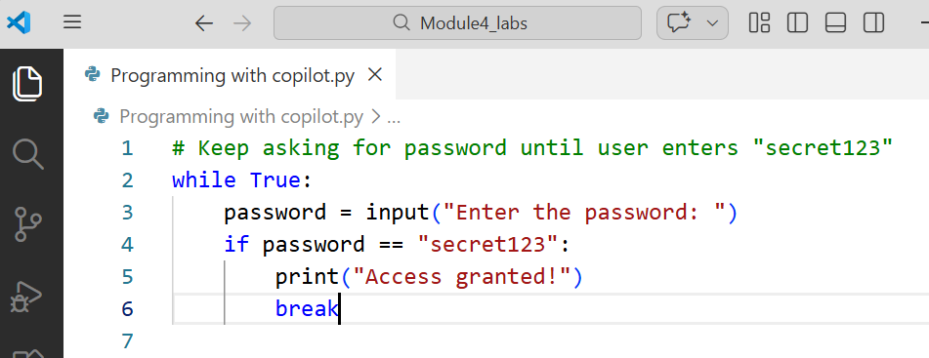
While Loop with Copilot
while loop: Executes as long as condition remains True
Python Syntax:
while condition:
# indented code block
# usually update variables to eventually make condition False
Common use: User input validation, games until win/loss
Copilot example prompt:
# Keep asking for password until user enters "secret123"
Copilot suggests:
while True:
password = input("Enter the password: ")
if password == "secret123":
print("Access granted!")
break
Notes:
Unlike for loops, while loops are condition-driven and useful when the exact number of iterations is unknown in advance.
Critical: Ensure the condition eventually becomes False to avoid infinite execution.
Here is a practical authentication scenario.
Live demo:
[Type the comment in VS Code]
Copilot proposes the loop with input().
Accept, run → test with wrong password (loop continues),
then "secret123" (exits).
Note: input() requires user interaction in the terminal.
This pattern is common in real applications for validation.

Slide 9
Loop Tips & Common Mistakes
Best practices:
Always update loop control variable inside loop (for while)
Use meaningful variable names (e.g., counter, item)
Prefer for over while when iterating known sequences
Common mistakes & warnings:
Infinite loop: Condition never becomes False (e.g., forgot to increment)
Example bad code:
count = 0
while count < 5:
print(count)
# Missing: count += 1
Use break to exit early; continue to skip iteration
Notes:
Loops are powerful but require discipline to prevent issues. The most frequent beginner error is the infinite loop, where the exit condition is never met due to missing updates.
In severe cases, this can freeze the editor or consume resources – press Ctrl+C to interrupt in terminal.
Always test small: run with small limits first. break exits the loop immediately; continue skips to next iteration.
Example: in while loop, if invalid input → continue to ask again. Copilot can help spot/fix these: highlight issue → add comment "# This might be infinite, add increment".
Mastering these safeguards leads to reliable code. Next, we discuss why efficiency matters and how Copilot enhances it.

Slide 10
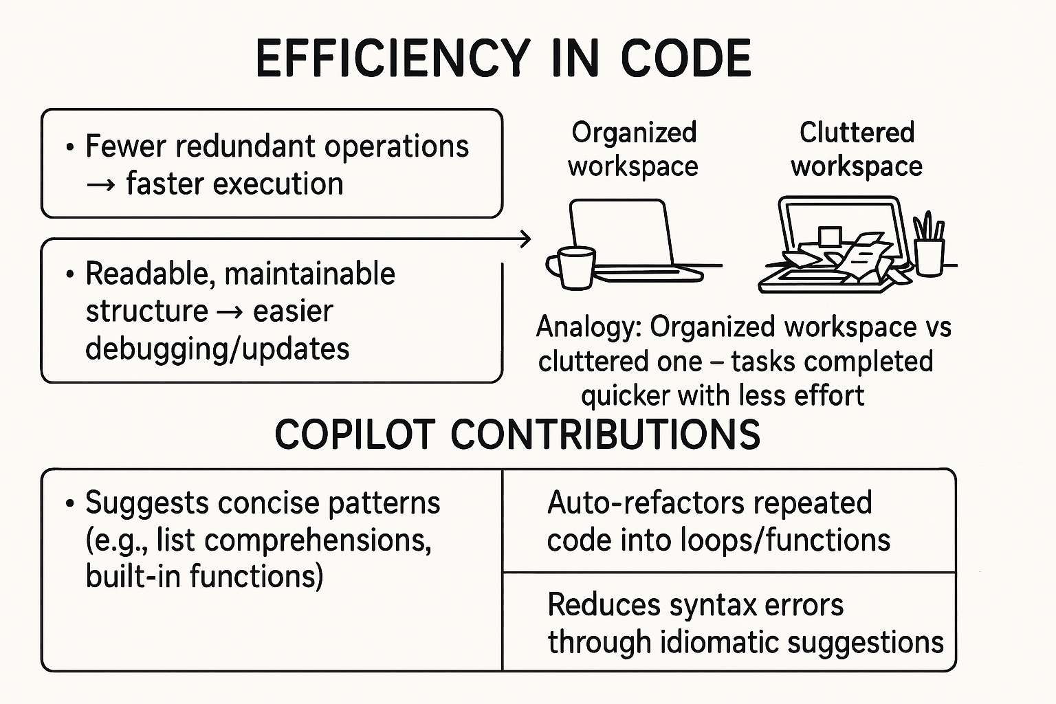
Efficiency: How Copilot Helps
Efficiency in code:
Fewer redundant operations → faster execution
Readable, maintainable structure → easier debugging/updates
Analogy:
Organized workspace vs cluttered one – tasks completed quicker with less effort
Copilot contributions:
Suggests concise patterns (e.g., list comprehensions, built-in functions)
Auto-refactors repeated code into loops/functions
Reduces syntax errors through idiomatic suggestions
Benefit: Focus on logic/problem-solving, not boilerplate
Notes:
As programs grow, efficiency becomes critical – both runtime performance and developer productivity. Clean, efficient code runs faster, uses less memory, and is simpler to modify later. Copilot acts as an efficiency accelerator: it recognizes repetitive patterns and proposes better alternatives. For instance, it might convert five similar print statements into a single for loop. This frees you to concentrate on the core problem rather than syntax details. In professional settings, this skill distinguishes efficient developers.

Slide 11

Lab Activity
Lab 4.1 - Loops with Copilot

Slide 12
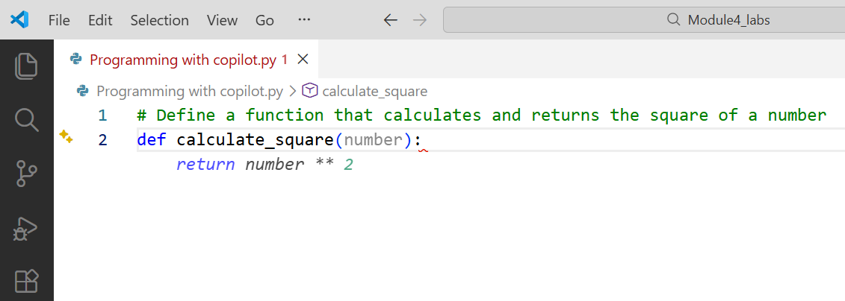
What are Functions & Defining Function with Copilot
Functions are reusable blocks of code that perform a specific task
Benefits: modularity, readability, easier testing/maintenance
Basic syntax:
def function_name(parameters):
# code block
# optional return value
Copilot example prompt:
# Define a function that calculates and returns the square of a number
Copilot may suggest:
def calculate_square(number):
return number ** 2
Notes:
Functions allow us to encapsulate logic that will be reused multiple times, reducing duplication and improving code organization.
In larger programs, this modularity becomes essential for collaboration and debugging.
Live demonstration:
[Open VS Code, type the comment exactly as shown]
Copilot generates the function definition with return.
Accept (Tab), then test below:
result = calculate_square (5)
print(result) # Output: 25
Change to calculate_square (3.5) → observe float handling.
This illustrates how Copilot produces correct, concise function skeletons from descriptive intent.
Always name functions clearly (verb + noun pattern recommended: calculate_area, check_even).

Slide 13
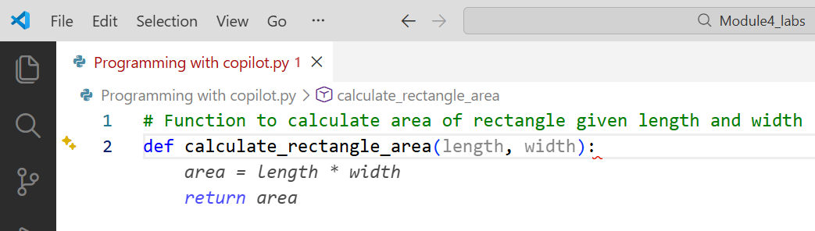
Function Parameters & Return Values
Parameters:
Variables listed in parentheses – receive values when function is called
Positional: order matters
Can have default values: def greet(name="Guest"):
Return:
Sends value back to caller (optional – defaults to None)
Python Code
def add(a, b):
return a + b
Copilot prompt example:
# Function to calculate area of rectangle given length and width
Copilot may suggest:
def calculate_rectangle_area(length,width):
area = length * width
return area
Notes:
Parameters act as inputs, allowing the same function to work with different data without rewriting code. The return statement determines what the function produces for use elsewhere.
Live example in VS Code:
[Type comment for rectangle_area]
Accept suggestion.
Then demonstrate calling:
area = calculate_rectangle_area (10, 5)
print("Area:", area) # Output: Area: 50
Copilot frequently suggests sensible defaults when prompted descriptively. Understanding parameters and return is foundational for building modular programs.

Slide 14
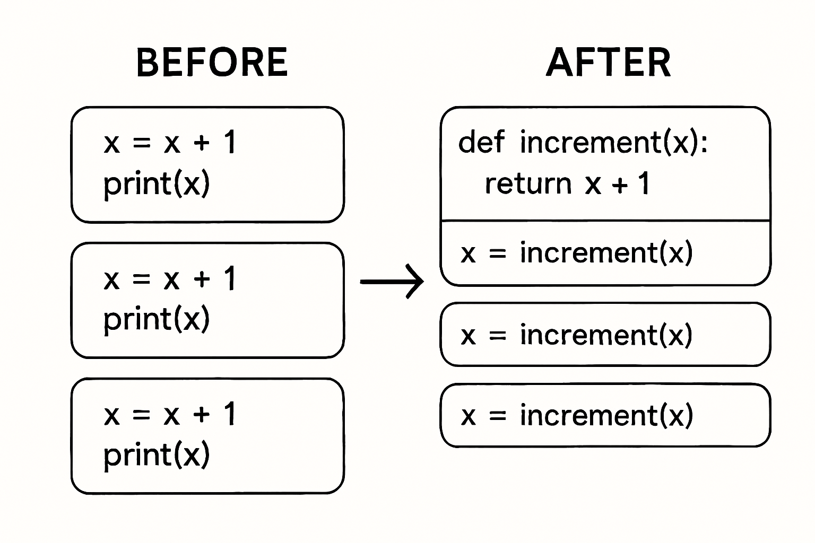
Why Functions Make Code Better – DRY Principle
DRY: Don't Repeat Yourself
Avoid duplicating logic → reduces bugs and maintenance effort
Advantages of using functions:
Single place to fix/update logic
Improved readability (code tells what, not how)
Easier testing (test function in isolation)
Reusability across programs/projects
Without functions: repeated code blocks → hard to maintain
With functions: central definition → call many times
Source: Image generated using AI
Notes:
The DRY principle is a cornerstone of good software engineering. Every time logic is duplicated, the risk of inconsistency and future bugs increases. Functions enforce DRY by centralizing behavior.
Diagram Explanation: left shows three similar calculation blocks; right shows one function called three times]
Example impact: if tax calculation changes, edit one function instead of searching multiple places.
In team settings or long-term projects, this discipline saves significant time and reduces errors.
Copilot reinforces DRY: when it detects repetition, it often suggests extracting to a function.
We now apply these concepts to organizing collections of data using data structures.

Slide 15
Lab Activity
Lab 4.2 - Functions Factory

Slide 16
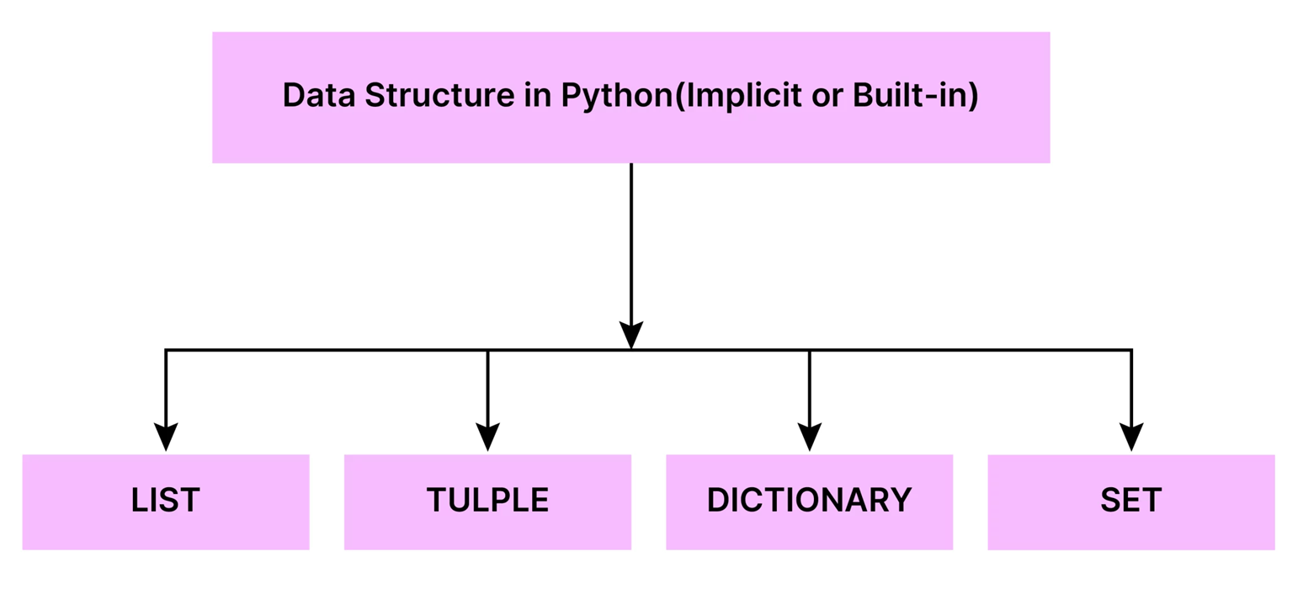
Data Structures Basics with Copilot
Data structures organize and store multiple related values
Why needed: Single variables insufficient for collections (e.g., all student names, shopping items)
Python built-in types:
list: ordered, mutable collection (like a shopping bag)
dictionary: key-value pairs (like a phone book)
tuple: Immutable sequence (Like a fixed checklist)
set: Unordered, unique items (Like a bag of distinct tokens)
Source: https://www.analyticsvidhya.com/blog/2024/07/python-built-in-data-structures/
Notes:
Single variables are great for storing one value, but they fall short when we need to manage collections—like a list of student names or items in a shopping cart. That’s where data structures come in.
Now, Python gives us several built-in types:
List: This is an ordered, mutable collection. Imagine a shopping bag—you can add, remove, or rearrange items. Lists are perfect when order matters and you expect to modify the contents.
Dictionary: This stores key-value pairs, like a phone book. You look up a value using a key. It’s ideal for structured data—like mapping student names to their grades.
Tuple: This is an immutable sequence. Once created, it can’t be changed. Think of it like a fixed checklist—great for data that shouldn’t be altered, like coordinates or configuration settings.
Set: This is an unordered collection of unique items. No duplicates allowed. It’s useful for membership tests or removing duplicates from a list—like filtering out repeated entries in survey responses.
Each of these structures has its own strengths. Choosing the right one depends on your task—whether you need order, mutability, uniqueness, or fast lookups.

Slide 17
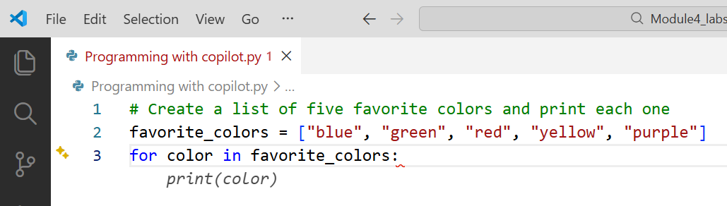
Data Structures Basics with Copilot
List creation & basic access:
fruits = ["apple", "banana", "cherry"]
print(fruits[0])
fruits.append("date“)
Copilot prompt example:
# Create a list of five favorite colors and print each one
Copilot may suggest:
colors = ["red", "blue", "green", "yellow", "purple"]
for color in colors:
print(color)
Notes:
Most real programs handle collections of data – scores, names, products, transactions. Lists and dictionaries provide efficient ways to store and manipulate these collections.
A list is ordered and changeable; elements accessed by integer index (0-based).
Live demo: [Type the comment about favorite colors]
Copilot generates list + loop. Accept, run → see each color printed.
Add .append("orange") → show dynamic growth.
Lists support many built-in methods (len(), remove(), sort(), etc.) – we cover key ones next. This sets the foundation for processing groups of items efficiently.

Slide 18
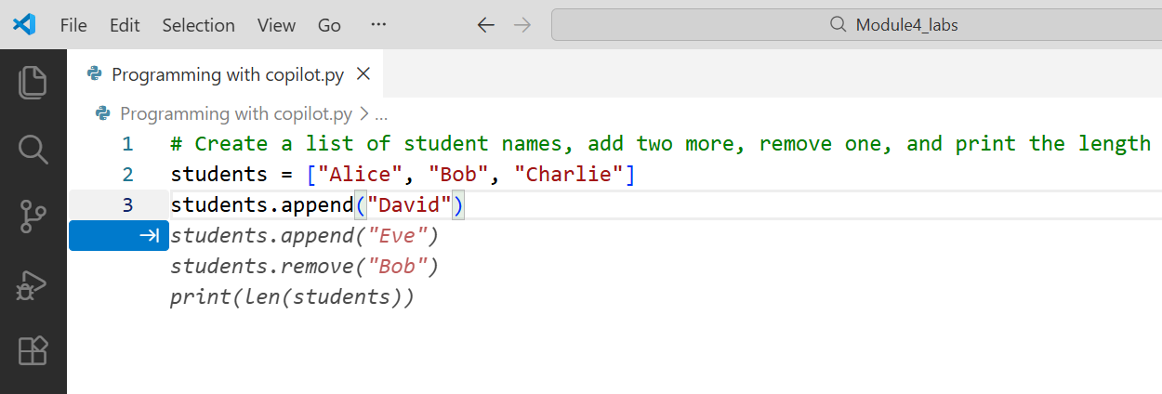
Data Structures Basics with Copilot
Common List Operations
Example with Copilot prompt:
# Create a list of student names, add two more, remove one, and print the length
Copilot may suggest:
students = ["Alice", "Bob", "Charlie"]
students.append("David")
students.append("Eve")
students.remove("Bob")
print(len(students))
Key list methods and operations:
append(item) – add to end
remove(item) – remove first occurrence
pop(index) – remove & return by index
len(list) – number of elements
list[index] – access by position (0-based)
Iteration: for item in my_list:
Notes:
Lists are mutable sequences, meaning we can modify them after creation. The methods shown are among the most frequently used in practice.
Live demonstration:
[Type the comment prompt in a new cell or file]
Accept Copilot’s suggestion (or refine if needed).
Run step-by-step: observe list growth with append, removal, and final length.
Try accessing: print(students[1])
Note: IndexError occurs if index is out of range – we address errors later.
These operations form the foundation for managing ordered collections.
We now move to dictionaries, which store data using meaningful keys rather than positions.

Slide 19
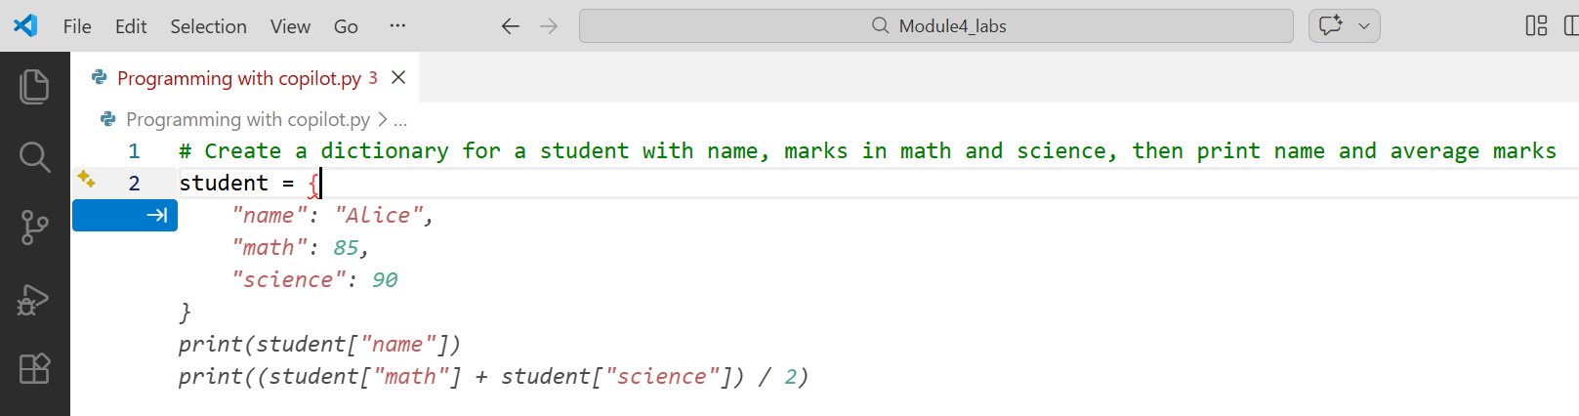
Data Structures Basics with Copilot
Dictionaries (Key-Value Pairs) – Basics
Copilot prompt example:
# Create a dictionary for a student with name, marks in math and science, then print name and average marks
Copilot may suggest:
student = {
"name": "Alice",
"math": 85,
"science": 90
}
print(student["name"])
print((student["math"] + student["science"]) / 2)
Dictionary: unordered, mutable collection of key-value pairs
Keys: unique, immutable (usually strings or numbers)
Values: any data type
Syntax:
student = {"name": "Ali", "age": 19, "grade": "A"}
Access: student["name"] → "Ali"
Add/update: student["city"] = "Cairo"
Notes:
Dictionaries provide fast lookup using meaningful keys instead of numeric indices. They are ideal for structured data such as student records, configuration settings, or simple databases.
Live demo:
[Enter the comment prompt] Accept suggestion. Run → see formatted output. Add a key: student["attendance"] = 95 → demonstrate dynamic addition. Update: student["math"] = 88 → show mutability. Keys must be unique; duplicate keys overwrite previous values. This structure is widely used in data processing and APIs.

Slide 20
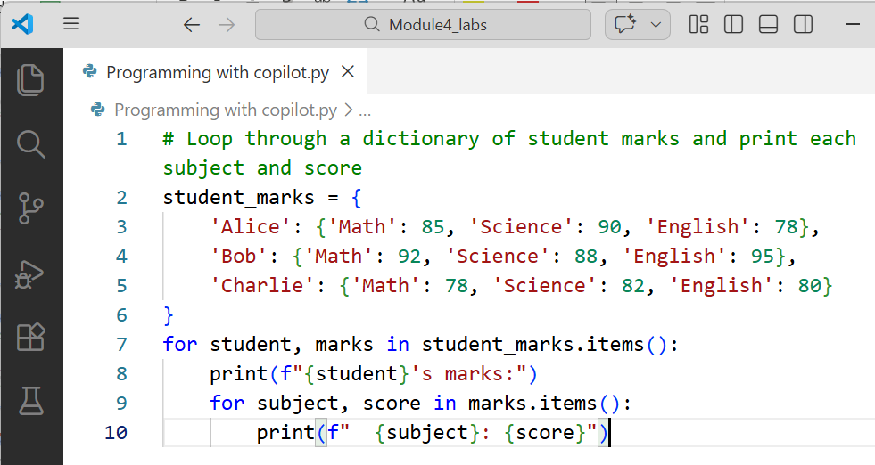
Data Structures Basics with Copilot
Access & Update Dictionaries
Copilot prompt:
# Loop through a dictionary of student marks and print each subject and score
Copilot may suggest:
Common operations:
Access: value = dict[key] (KeyError if missing)
Safe access: dict.get(key, default)
Update: dict[key] = new_value
Delete: del dict[key]
Iteration:
Keys: for key in student:
Values: for value in student.values():
Both: for key, value in student.items():
Notes:
Dictionaries are powerful for lookup and modification, but require care with missing keys. The .get() method prevents KeyError by returning a default value.
Live demonstration:
[Type the iteration prompt]
Accept → run and observe clean output.
Alternative: try for key in marks: then print(key, marks[key]) – same result, but .items() is more readable. Practice: add a new subject, then loop again to confirm update. These iteration patterns are essential when processing collections of related data.
We now shift to principles that maximize Copilot’s effectiveness.

Slide 21
Lab Activity
Lab 4.3 - Data Structures Dive

Slide 22
AI-Assisted Programming Principles + Effective Prompting
Core principles for using Copilot effectively:
Write clear, specific, natural-language comments describing intent
Provide context (variable names, expected input/output)
Iterate: accept, test, refine prompt if needed
Always review and understand generated code
Use Copilot as a partner, not replacement for logical thinking
Good Prompt:
# Use a list comprehension to create a list of even numbers from 1 to 20
Better Prompt:
# Create list of even numbers 2–20 using list comprehension, then print sum
Vague Prompt (avoid):
# list even
Notes:
Copilot performs best when given precise instructions in comment form. The quality of the prompt directly influences suggestion accuracy and completeness.
Live example:
[Type vague prompt first → show limited or incorrect suggestion]
Then type detailed version → observe richer output (list comprehension + sum).
Accept → run: evens = [x for x in range(1,21) if x % 2 == 0]; print(sum(evens)) → 210
This iterative refinement skill separates effective AI-assisted coding from passive acceptance.
Next, we address one of the most critical intermediate skills: debugging with and without AI help.

Slide 23
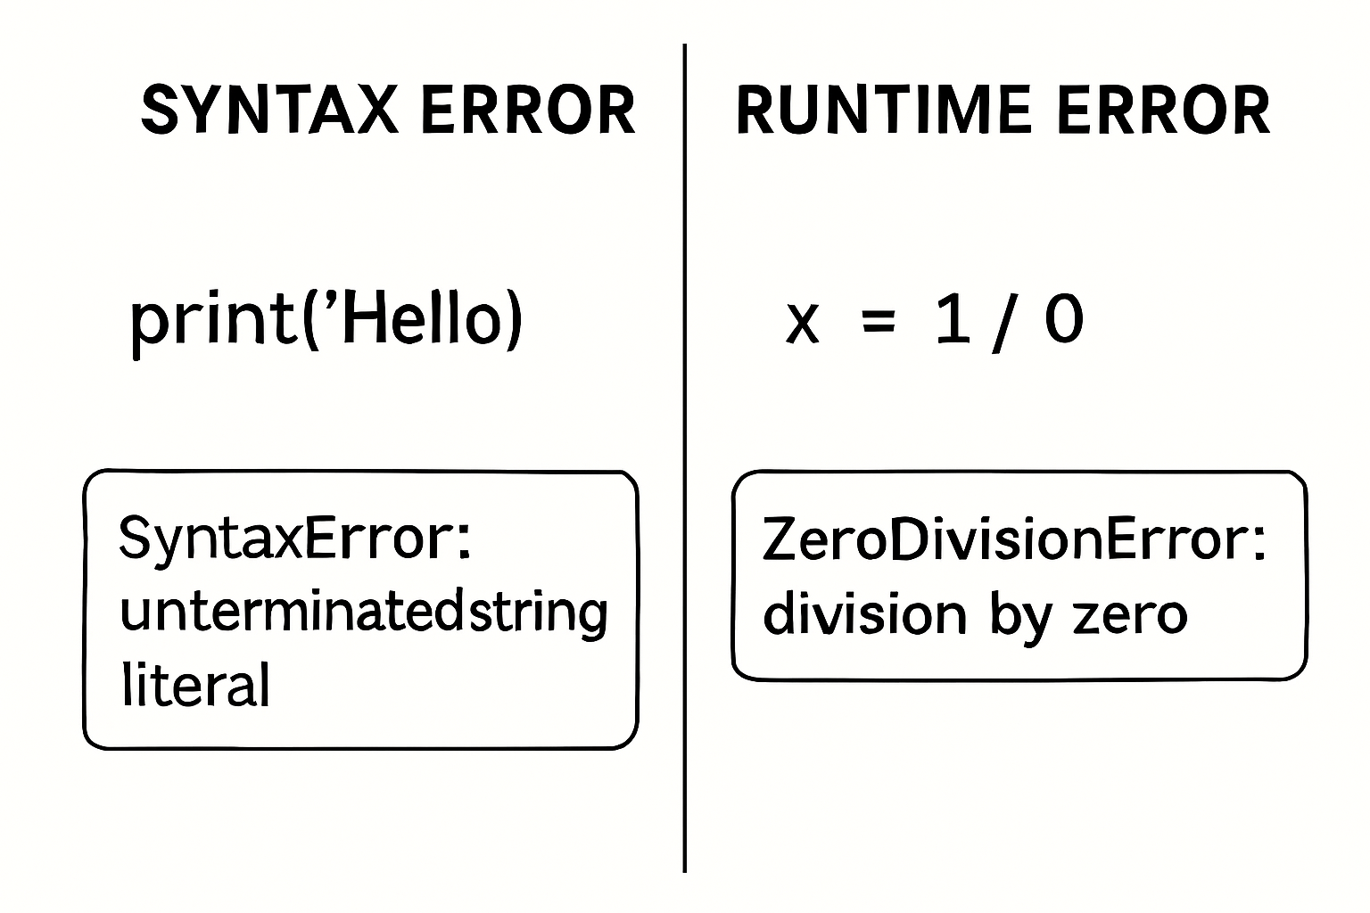
Debugging Essentials
Common Errors
Debugging: systematic process of finding and fixing errors (bugs)
Two main categories:
Syntax errors: code structure invalid (caught before run)
Runtime / Logic errors: code runs but produces wrong results or crashes
Frequent beginner errors:
NameError:
TypeError:
IndexError:
KeyError:
variable/ name not defined
operation on incompatible types (e.g., "2" + 3)
list index out of range
missing dictionary key
Notes:
Even experienced programmers write bugs; the difference lies in efficient diagnosis and correction. Syntax errors prevent execution; runtime and logic errors require investigation.
Common causes:
NameError: typo in variable name or use before assignment
TypeError: forgetting to convert input() string to int/float
IndexError: accessing list[5] when len(list) = 4 Read error messages carefully – they usually indicate file, line number, and issue type.
Copilot and manual debugging complement each other. We next examine how to leverage Copilot specifically during the debugging process.

Slide 24

Debugging Essentials
Read the error message carefully (file, line number, error type)
Identify the problematic line/code block
Reproduce the error with minimal test case
Hypothesize the cause (logic, type mismatch, missing import, etc.)
Test small fixes → run and observe
Verify solution works across cases (edge cases included)
Step-by-Step Debugging Workflow
Print debugging tip: insert print() statements to trace variable values
Source: https://www.geeksforgeeks.org/blogs/debugging-tips-to-get-better-at-it/
Notes:
Effective debugging follows a repeatable, logical process rather than random changes. This workflow minimizes time wasted and builds systematic problem-solving skills
Example application: IndexError on line 12 → check list length before access, add condition or use .get(). Print debugging remains valuable even with advanced tools:
print(f"Before loop: counter = {counter}")
# loop code
print(f"After loop: counter = {counter}")
helps trace where values deviate from expectation. Adopt this method consistently; it becomes faster with practice. Next, we see how Copilot integrates into and accelerates this workflow.

Slide 25
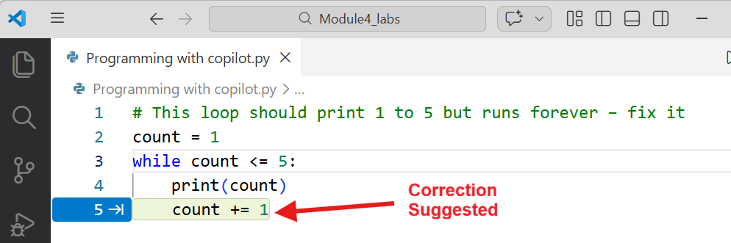
Debugging Essentials
Using Copilot for Debugging
Copilot debugging techniques:
Highlight error line → write comment: # Why am I getting NameError here?
Use inline command: type /fix or /explain after error
Add descriptive comment above buggy code:
# This loop should print 1 to 5 but runs forever – fix it
count = 1
while count <= 5:
print(count)
Copilot suggests adding count += 1
Always: Review, test, and understand suggested fix before accepting
Notes:
Copilot is not only a code generator but also an effective debugging assistant when used intentionally.
Live demonstration (prepare a small buggy snippet beforehand):
[Open file with intentional infinite while loop]
Type the comment as shown → accept suggestion → run again → confirm it now terminates.
Alternative: highlight line with TypeError → write # /fix this concatenation error → observe suggestion.
Important: Never accept blindly. Read the proposed change, reason why it addresses the issue, and test thoroughly.
This combination of human reasoning + AI speed produces faster, more reliable corrections.
We now address the professional and ethical responsibilities that accompany AI-assisted coding.

Slide 26
Lab Activity
Lab 4.4 - Debug Detective – Find, Fix & Optimize

Slide 27
Ethical AI Coding Reminder
Key ethical principles when using Copilot / generative AI:
Understand every line of code you submit or use
Verify correctness: test outputs, edge cases, security implications
Do not present AI-generated code as entirely your own in assessments
Attribute appropriately when required (e.g., in open-source or reports)
Be aware of potential biases, hallucinations, or insecure suggestions in AI output
Professional standard: AI is a tool – final responsibility remains with the programmer
Discussion prompt: “What should you do if Copilot suggests code that works but you don’t fully understand?”
Notes:
As AI tools become integral to programming, ethical usage is a core competency.
[Pause briefly to let students read points]
You are accountable for the code’s behavior, security, correctness, and compliance - not the AI. In academic or professional contexts, blindly copying without comprehension undermines learning and integrity.
Real-world example: Copilot might suggest outdated or insecure practices (e.g., using eval(), weak hashing) – always cross-check.
Class discussion (2–3 minutes if time allows):
“What steps would you take if you receive a suggestion you don’t fully understand?”
Expected answers: research, ask instructor/peer, test extensively, rewrite in your own words. Responsible use accelerates learning; irresponsible use hinders it.
With theory complete, let us recap the key concepts covered today.

Slide 28

Summary
You have learned in this Chapter:
Implementation of control flow structures using precise, intent-driven Copilot prompts
Definition and application of functions, including parameters, return values, and invocation, to uphold the DRY principle and support modular design
Effective use of fundamental data structures: ordered, mutable lists and key-value dictionaries for structured data management
Application of a systematic debugging methodology, augmented by Copilot capabilities (/fix, /explain, and descriptive error-resolution comments)
Adherence to ethical standards in AI-assisted programming: full comprehension, rigorous verification, and personal accountability for all code produced

Slide 29
Reference
https://realpython.com/python-debugging-pdb/
https://docs.python-guide.org/writing/style/
https://github.com/microsoft/prompt-engineering
https://docs.github.com/en/copilot/using-github-copilot/best-practices-for-using-github-copilot
https://docs.python.org/3/tutorial/datastructures.html
https://docs.python.org/3/tutorial/controlflow.html

Slide 30

QUIZ
Let’s Start

Slide 31


Quiz
Which of the following best describes the primary purpose of writing clear, specific, context-rich comments when using Copilot?
To make the code look more professional
To elicit accurate, idiomatic, and complete code suggestions from Copilot
To replace the need for understanding the generated code
To increase the font size of suggestions in VS Code
Answer: B
To elicit accurate, idiomatic, and complete code suggestions from Copilot

Slide 32
Quiz
2. What does the DRY principle stand for, and why is it emphasized when introducing functions?
Don't Repeat Yourself – to reduce code duplication and improve maintainability
Debug Rapidly Yourself – to speed up error correction
Define Return Yield – to clarify function syntax
Data Reuse Yield – to focus on data structures
Answer: A
Don't Repeat Yourself – to reduce code duplication and improve maintainability

Slide 33
Quiz
3. Which loop is most appropriate when the number of iterations is known in advance (e.g., processing a fixed list of items)?
while loop
for loop
infinite loop
recursive loop
Answer: B
for loop

Slide 34
Thank You

